Slide 1
Java 8 Features
Presenters:
Regis Charles | Pankaj Yadav
Vishal Chavda
Uma Vete
Sunil Kumar Perumalla

Slide 2
Agenda
Brief about following Java 8 features
Functional Interfaces & Lambda Expression
Method References
Optional
Stream API
Date and Time APIs

Slide 3
Functional Interface
Single Abstract method
we do not have more than one abstract method
In java 8 introduce @FunctionalInterface annotation

Slide 4
@FunctionalInterface
It will make sure that it is functional interface means if we try to add more than one abstract method it will throw compile time error.
But we can add default and static method.
functional interfaces are used in stream API.
Ex: Runnable, Comparator only one abstract method .

Slide 5
Lambda expression
A Lambda expression is a concise representation of an anonymous function that can be passed around, it does not have a name, it has list of parameters, body, return type and possibly a list of exceptions that can be thrown.
What is the syntax of lambda expression?
(Arguments list)->{expression;} or
(Arguments list)->{statements;}

Slide 6
anonymous – because it does not have an explicit name
function - because lambda is not associated with particular class
passed around – Lambda can be expressed as an argument to a method or stored in a variable
concise - you don't need to write boiler plate code means repeated code. like we do for anonymous class and more readable.

Slide 7
java.util.function
java.util.function package function interfaces are categorized into 4 types
Consumer: Accepts an argument, returns nothing.
Function: Accepts an argument, returns a value.
Predicate: Accepts an argument, returns a boolean value.
Supplier: Does not accept an argument, returns a value.

Slide 8
Method References
What is Method Reference.(::)
Static or instance
How to use
ClassName :: methodname
ObjectRef :: methodname
ClassName :: new

Slide 9
Method References
Why we should go for Method Reference.
How to use with Static method
How to use with instance method
Constructor reference

Slide 10
Basics of Stream API

Slide 11

What is Stream API ?
Java provides a new additional package in Java 8 called java.util.stream
Stream does not store elements. It simply conveys elements from a source such as a data structure, an array, or an I/O channel, through a pipeline of computational operations.
Stream is functional in nature. Operations performed on a stream does not modify original source.

Slide 12
We require the Stream API because
It supports aggregate operations which makes the processing simple.
It supports Functional-Style programming.
It does faster processing. Hence, it is apt for better performance.
It allows parallel operations.

Slide 13
For example, filtering a Stream obtained from a collection produces a new Stream without the filtered elements, rather than removing elements from the source collection.
Stream is lazy and evaluates code only when required.
The elements of a stream are only visited once during the life of a stream. Like an Iterator, a new stream must be generated to revisit the same elements of the source.

Slide 14
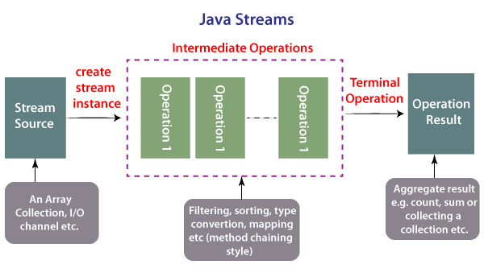

Slide 15
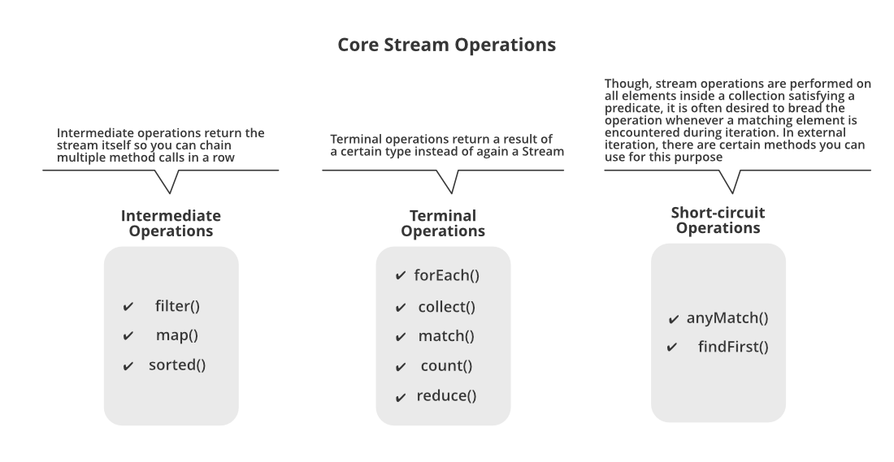

Slide 16
Java Stream distinct() Method
The elements are compared using the equals() method. So it’s necessary that the stream elements have proper implementation of equals() method.
Stream distinct() with custom objects
That's why it's very important to implement equals() method if you are planning to use stream distinct() method with custom objects. Note that both equals() and hashCode() methods are used by Collection classes API to check if two objects are equal or not.

Slide 17
Frequently used Methods in Collection
Finding Sum, min, max, average, and string concatenation are all special cases of reduction.
find the max and min values from the stream
Stream.max(comparator) : It is a terminal operation that returns the maximum element of the stream according to the provided Comparator.
Stream.min(comparator) : It is a terminal operation that returns the minimum element of the stream according to the provided Comparator.
Summing a stream of numbers can be expressed as: reduce()/reduction method

Slide 18
What is the difference between limit and skip?
The limit(n) method is another intermediate operation that returns a stream not longer than the requested size. As before, the n parameter can't be negative.
The skip(n) method is an intermediate operation that discards the first n elements of a stream. The n parameter can't be negative, and if it's higher than the size of the stream, skip() returns an empty stream.

Slide 19
Optional
Java introduced a new class Optional in jdk8. It is a public final class and used to deal with NullPointerException in Java application. You must import java.util package to use this class. It provides methods which are used to check the presence of value for particular variable.
It helps us to avoid null pointer exception at the runtime and it also makes code very clean.

Slide 20
Optional
Features of Optional :
Null checks are not required.
No more NullPointerException at run-time.
We can develop clean and neat APIs.
No more Boiler plate code.
Different ways to create Optional are:
Optional.empty()
Optional.of()
Optional.ofNullable()

Slide 21
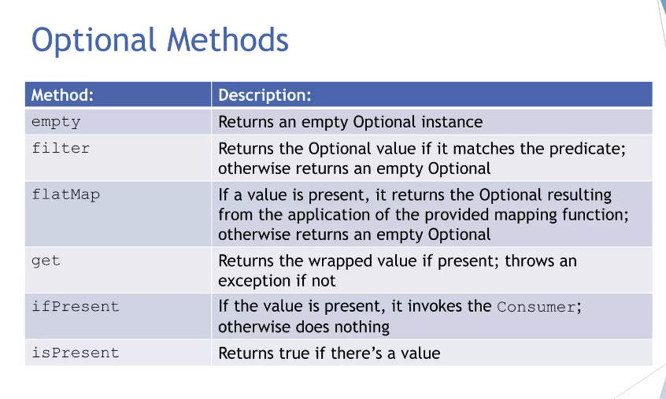
Optional Class Methods

Slide 22
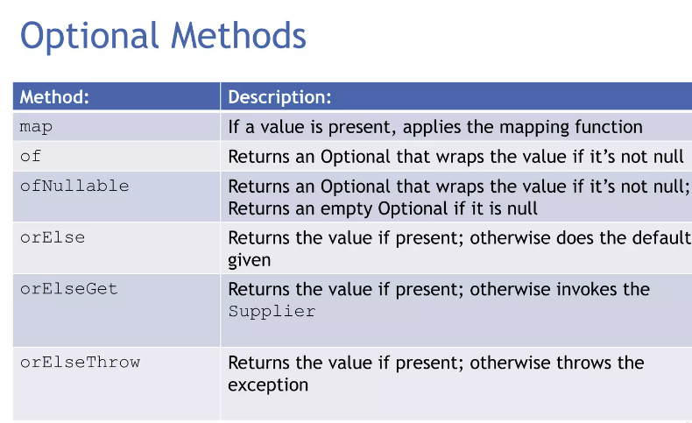
Optional Class Methods

Slide 23
Joda-Time API
Why Joda-Time API introduced :
Java 7 Date, Calender, Timezone classes are not well designed.
Date date=new Date(2023,12,31,13,30).
TimeZone zone = TimeZone.getInstance("America/NewYork");
Date is mutable.
Person p = new Person();
Date birthDay = p.getBirthDay();
birthDay.setTime();

Slide 24
Joda-Time API
Introduction:
Java 7 Date, Calender and Timezone are not upto the mark wrt to convenience and performance.
Oracle,1.8,joda.org,java.time
To get date we should go for LocalDate class.
To get time we should go for LocalTime class.
By using utility methods we can get dayofmonth,monthvalue,year,hour,minute,second,nano etc.
To represent Date and Time by using LocalDateTime class.

Slide 25
Joda-Time API
Continue..
To represent zone ZoneId object is used to represrent zone
We can get ZoneId for a particular zone.
Period object can be used to represent quantity of time.

Slide 26
THANK YOU

